Slide 1
Information system for Business Application

Slide 2
Classification of IS on the basis of organizational level
Four main types of IS serve different organizational level.
Operational level system
Knowledge level system
Management level system
Strategic level systems

Slide 3
Classification of IS on the basis of organizational level
Operational level system: information systems that monitor the elementary activities and transaction of the organization.
Knowledge level system: information system that support and data workers in the organization.

Slide 4
Classification of IS on the basis of organizational level
Management level system: information system that support the monitoring, controlling, decision making and administrative activities of middle managers.
Strategic level system: information system that support the long range planning activities of senior managers.

Slide 5
Classification of IS on the basis of functional level
IS also serves the major business functions such as
Sales and marketing
Manufacturing
Finance
Accounting
Human resource

Slide 6
Types of information systems
KIND OF INFORMATION SYSTEM
GROUPS SERVED
Strategic Level
Senior Managers
Management Level
Middle Managers
Knowledge Level
Knowledge and Data Workers
Operational Level
Operational Managers
Sales and Marketing
Manufacturing
Finance
Accounting
Human Resources

Slide 7
The six major types of information systems
TYPES OF SYSTEMS
Strategic-Level Systems
Executive Support Systems (ESS)
5-year sales trend forecasting
5-year operating plan
5-year budget forecasting
Profit plannig
Manpower planning
Management-Level Systems
Management Information Systems (MIS)
Sales managemnt
Inventory control
Annual budgeting
Capital investment analysis
Relocation analysis
Decision- Support Systems (DSS)
Sales region analysis
Production scheduling
Cost analysis
Pricing/profitability analysis
Contract cost analysis
Knowledge-Level Systems
Knowledge Work Systems (KWS)
Enginneering workstations
Graphics workstations
Managerial workstations
Office Automation Systems (OAS)
Word processing
Document imaging
Electronic calendars
Operational-Level Systems
Machine control
Plant scheduling
Material Movement control
Securities trading
Payroll
Accounts payable
Accounts receivable
Compensation
Training & development
Emplyee record keeping
Transaction Processing Systems (TPS)
Order tracking
Order processing
Cash management
Sales and Marketing
Manufacturing
Finance
Accounting
Human Resources

Slide 8
Interrelationships among systems
Executive support systems (ESS)
Management systems (MIS)
Management systems (DSS)
Knowledge systems (KWS and OAS)
Transaction processing systems (TPS)

Slide 9
Marketing Systems
Marketing systems are concerned with
Planning, promotion, and sale of existing products in existing markets
Development of new products and new markets
Better attracting and serving present and potential customers

Slide 10
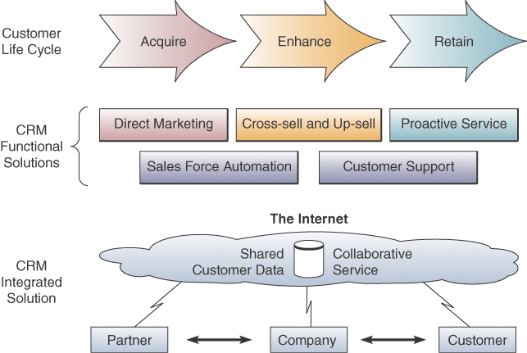
Marketing Information Systems

Slide 11
Interactive Marketing
Interactive Marketing
A customer-focused marketing process
Uses the Internet, intranets, and extranets
Establishes two-way transactions between a business and its customers or potential customers
Goal
Profitably use networks to attract and keep customers
Get customers to help create, purchase, and improve products and services

Slide 12
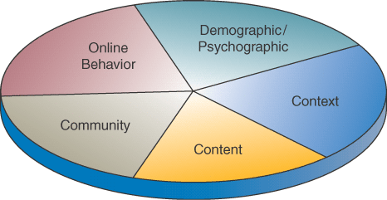
Targeted Marketing
An advertising and promotion management concept with five targeting components

Slide 13
Targeted Marketing Components
Community: customized ads to appeal to specific virtual communities
Content: ads placed on a variety of selected websites, aimed at a specific audience
Context: ads placed on web pages that are relevant to a product or service
Demographic/Psychographic: web marketing aimed at specific types or classes of people
Online behavior: promotions tailored to each visit to a site by an individual

Slide 14
Sales Force Automation
Outfit sales force with notebook computers, web browsers, and sales contact software
Connect them to marketing websites and the company intranet
Goals
Increase personal productivity
Speed up capture and analysis of sales data
Gain strategic advantage

Slide 15
Manufacturing Information Systems
Supports the production/operations functions
Includes all activities concerned with planning and control of the processes producing goods or services

Slide 16
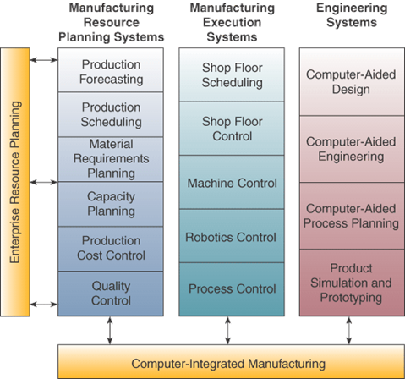
Computer-Integrated Manufacturing

Slide 17
CIM Objectives
Simplify production processes, product designs, and factory organization
Automate production processes and the business functions that support them
Integrate all production and support processes using
Networks
Cross-functional business software
Other information technologies

Slide 18
CIM Systems
Computer-aided manufacturing (CAM)
Automate the production process
Manufacturing execution systems (MES)
Performance monitoring information systems for factory floor operations
Process control
Control ongoing physical processes
Machine control
Controls the actions of machines

Slide 19
Human Resource Management (HRM)
Information systems designed to support
Planning to meet personnel needs
Development of employees to their full potential
Control of all personnel policies and programs

Slide 20
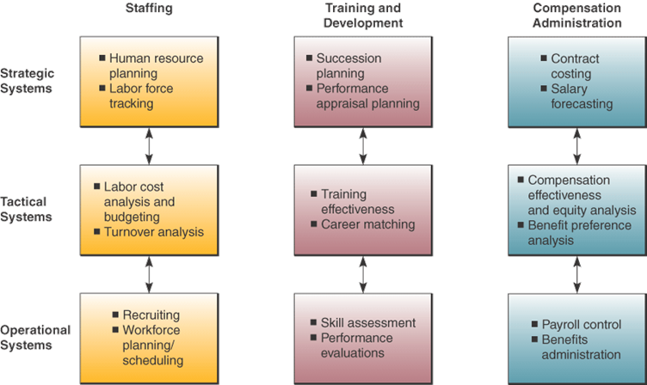
HRM Systems

Slide 21
HRM and the Internet
Recruiting employees using the corporate website and commercial recruiting services
Posting messages in selected Internet newsgroups
Communicating with job applicants via e-mail

Slide 22
HRM and Corporate Intranets
Corporate intranet uses
Process common HRM transactions
Allow around-the-clock HRM services
Disseminate information faster than through previous company channels
Collect information from employees online
Allow HRM tasks to be performed with little HRM department intervention
Training

Slide 23
Employee Self-Service
Intranet applications can allow employees to
View benefits
Enter travel and expense reports
Verify employment and salary information
Access and update personal information
Enter time-sensitive data

Slide 24
Accounting Information Systems
The oldest and most widely used information system in business
Records and reports business transactions and economic events
Produces financial statements
Forecasts future conditions
Typically consists of
Order processing
Inventory control
Accounts receivable
Accounts payable
Payroll
General ledger systems

Slide 25
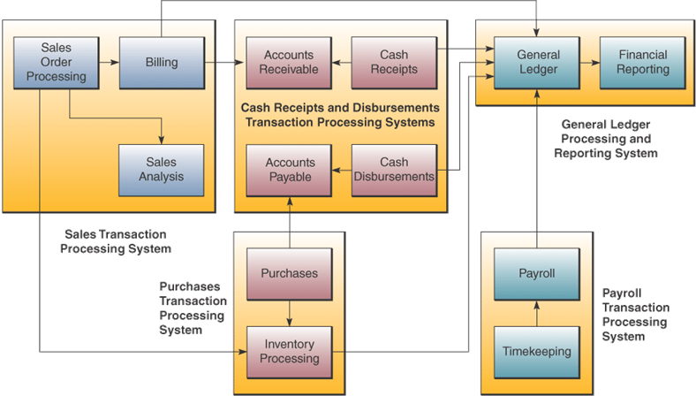
Accounting Information Systems

Slide 26
Financial Management Systems
Supports business managers and professionals making decisions concerning
The financing of a business
The allocation and control of financial resources within a business

Slide 27
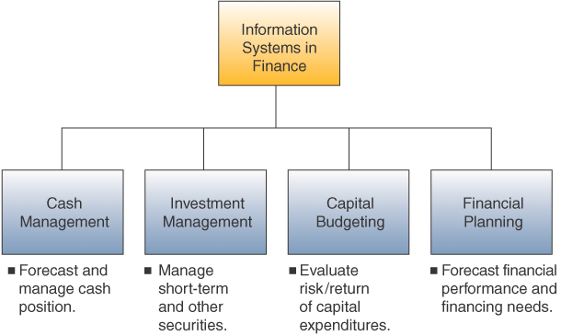
Financial Management System Example

